Slide 1





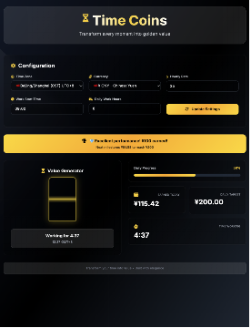
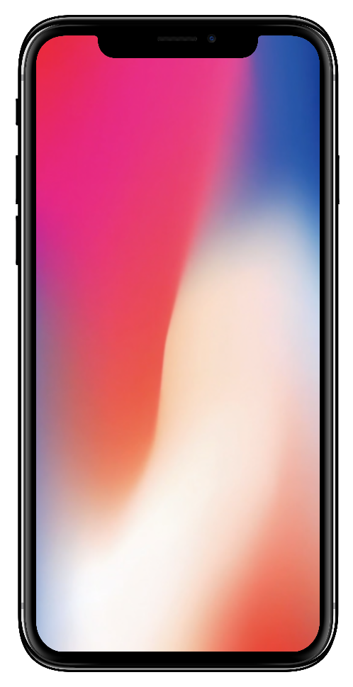
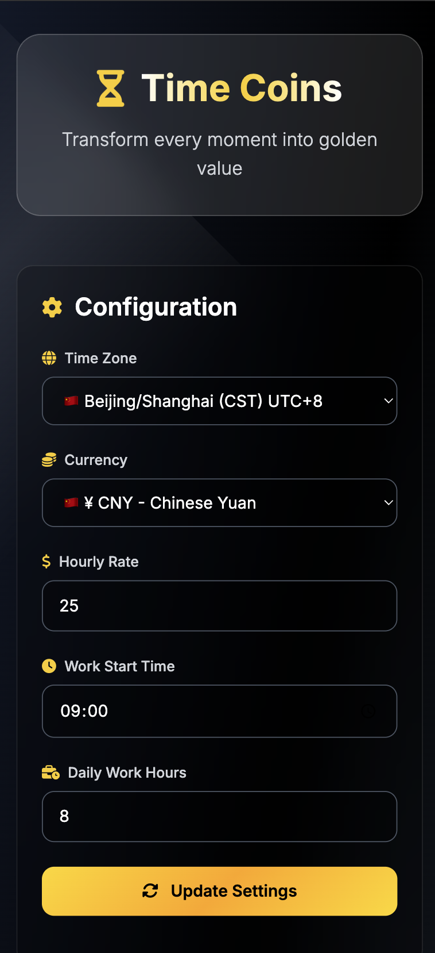
Notes:
Google search: device mockup filetype:pptx

Slide 2

PRESENTATION TEMPLATES
Stories worth telling…
WWW.POWERSLIDES.COM
Notes:
There is a background placeholder in this slide.
To change the images :
Right Click and Select Format Background -> Select FILL -> Picture Or Texture Fill -> Select File...

